Slide 1

Unsupervised Learning
By DSU Team
23/07/2021

Slide 2

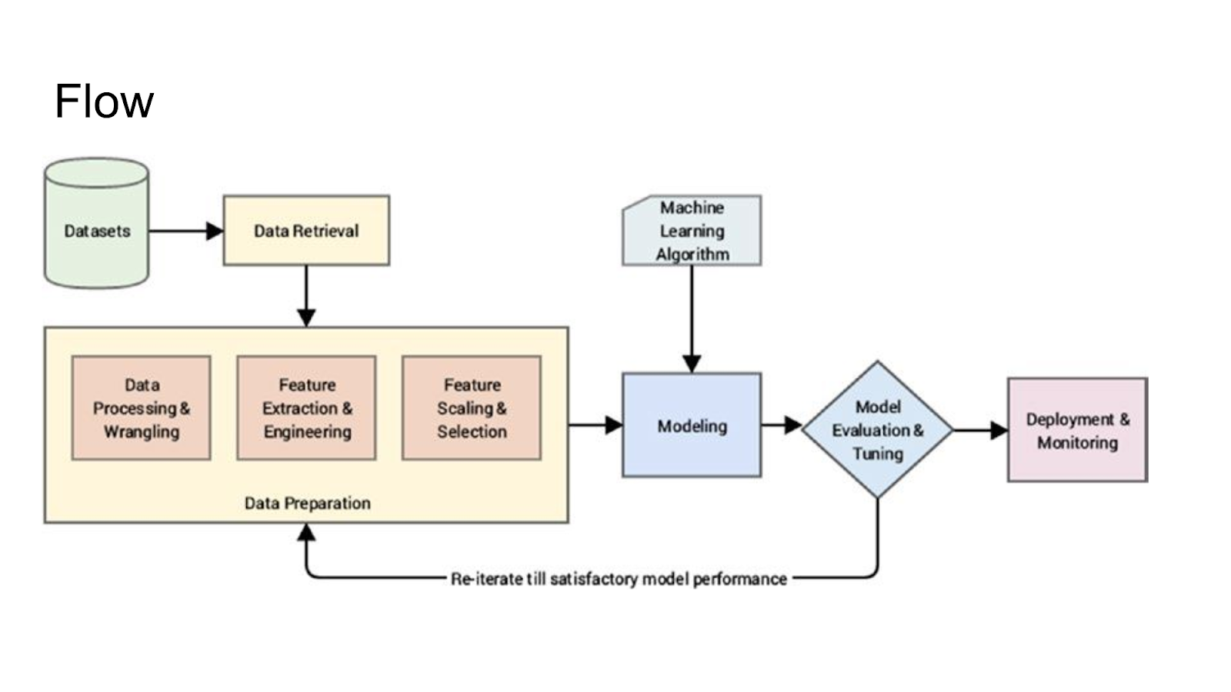
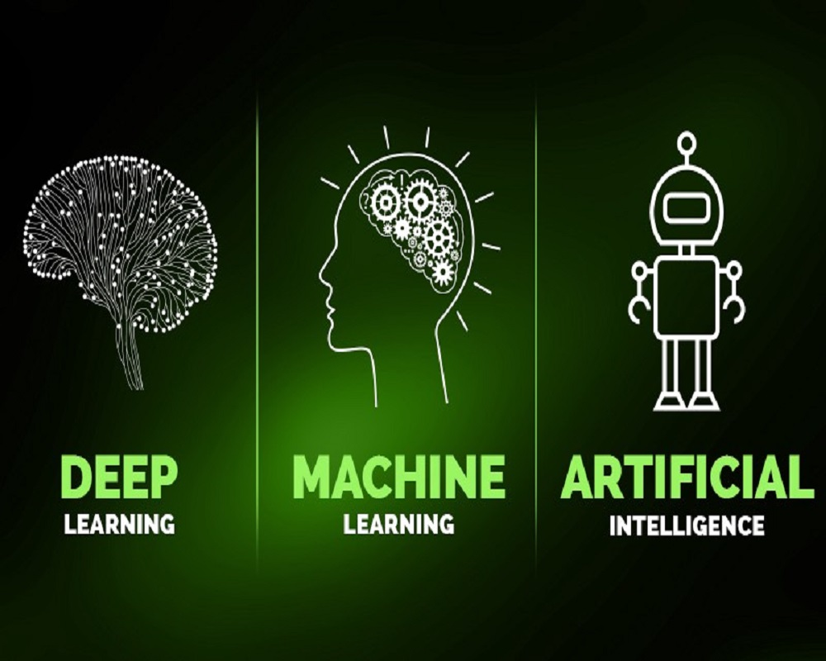

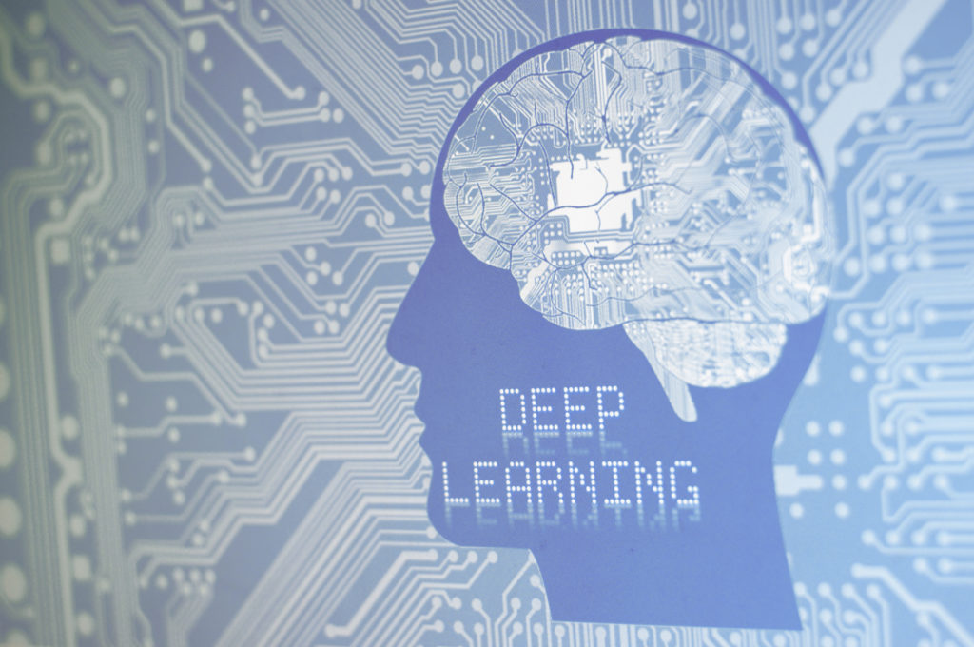
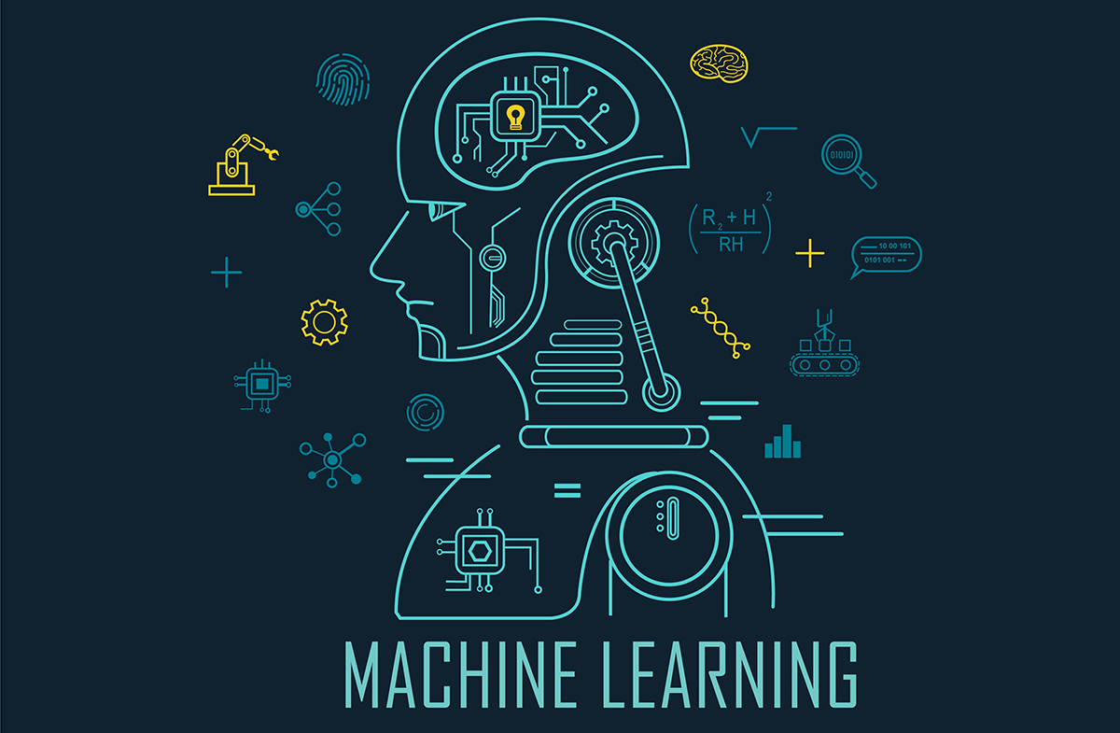
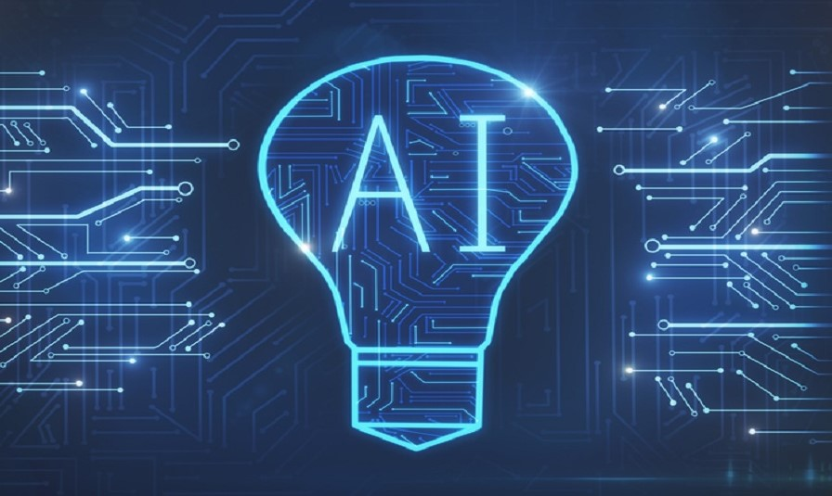
VS

Slide 3
VS

Slide 4
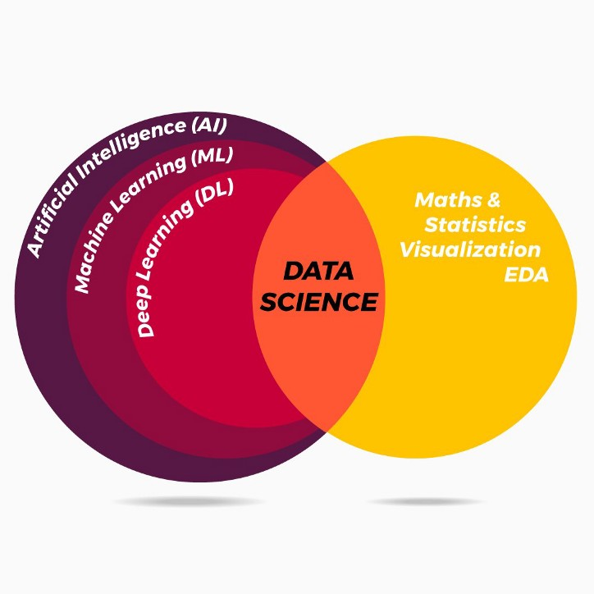

AI
Enables the machine to think(do things like humans do).
Week AI
Strong AI

Slide 5
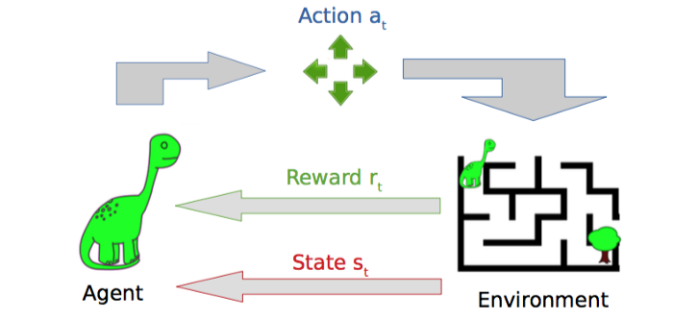
ML
Uses statistical tools to explore and analyze the data to provides machine to learn automatically from experience.
Supervised Learning
Unsupervised Learning
Reinforcement Learning

Slide 6
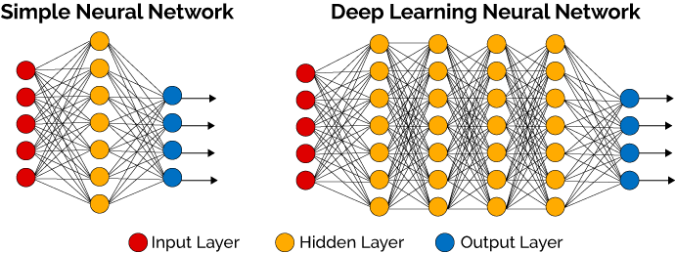
DL
Can we make the machine learn like like how human brain try to learn things? Using Multi Neural Network Architecture.
Artificial Neural Network
Convolution Neural Network
Recurrent Neural Netwok

Slide 7
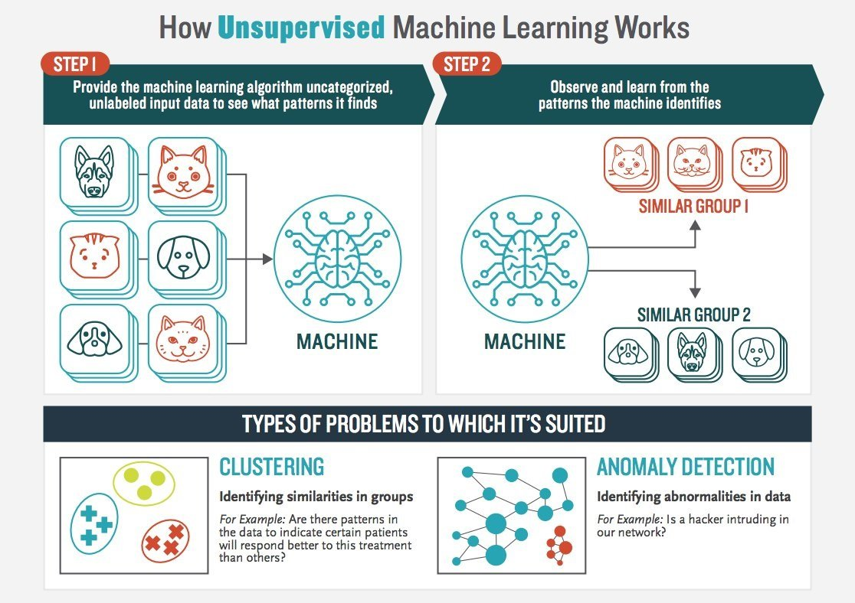
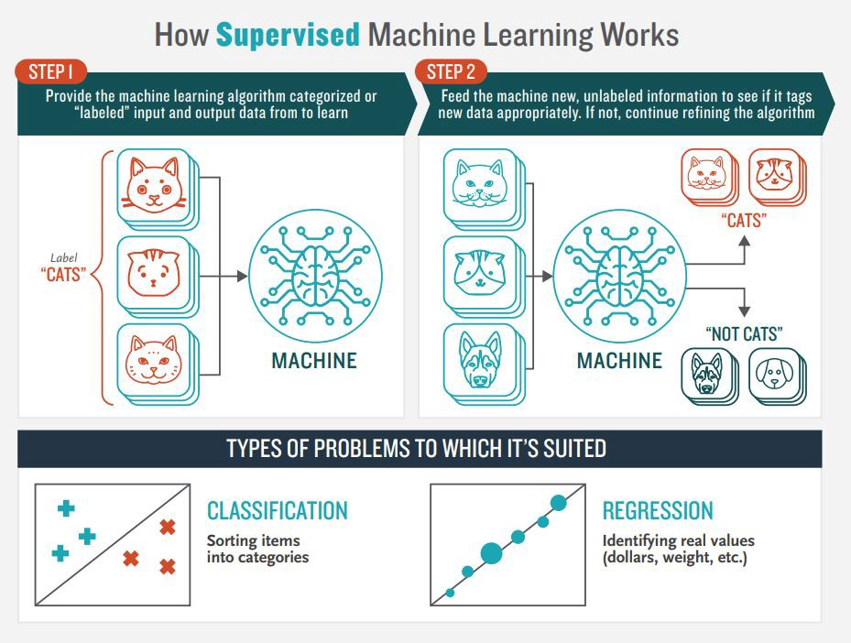

Slide 9
Type of Unsupervised Machine Learning
Clustering (K-means Clustering)
Process of grouping similar entities together.
Dimensionality Reduction (Principal Component Analysis)
The goal is to reduce the number of the dimension.
Association Rules (Apriori Algorithm)
Discovering the hidden relationship among objects.

Slide 10
01
Clustering
Exclusive (Hard) & Overlapping (Soft)
K-Means
Fuzzy C-Means
Hierarchical
Probabilistic
Gaussian Mixture Models (GMM)
Algoritma
02
Association
Apriori Algorithm
03
Dimensionality Reduction.
PCA
SVD

Slide 11
Studi Kasus
wholesale customers dataset | k-means

Slide 12

Referensi Belajar
Bacaan - IBM Unsupervised Learning
https://www.ibm.com/cloud/learn/unsupervised-learning
Cheat Sheet - Github [afshinea]
https://github.com/afshinea/stanford-cs-229-machine-learning/blob/master/en/cheatsheet-unsupervised-learning.pdf

